Slide 1

Smart Crop Protection System from Animals
By Team No.: 30
1.Aniket Gund (Leader)
2.Urvi Patil
3.Prajwal Shahane

Slide 2

Abstract
Animals are causing a lot of damage to crops, causing significant financial losses for farmers. To address this issue, we propose an automatic crop protection system leveraging the ESP32 microcontroller. The integration of PIR and Sound sensors enables the detection of obstacles, providing rapid alerts to farmers. Enhancing field security, the GSM module offers real-time location updates to guardians.

Slide 3

Aim:
To design and develop a smart crop protection system with the help of microcontroller.

Slide 4
Objectives:
Develop and deploy a comprehensive crop protection system to detect and deter wild animal messing with agricultural fields.
Establish a real-time alert mechanism to instantly notify farmers of any animal activity, allowing them to take immediate preventive measures.

Slide 5

Literature Survey
No. | Title of the Paper | Summary
1. | “SMART CROP PROTECTION USING ARDUINO" by Varshini B.M. | Proposes an Arduino Uno based framework utilizes a PIR sensor to identify intruders close to the field and additional to it a smoke sensor.
2. | "SMART PROTECTION SYSTEM TO MANAGE CROP VANDALIZATION USING RENEWABLE ENERGY” by Mohini S. Lohakare | Presents an system driven by the NODE MCU32S microcontroller, employs IoT technology to detect and deter animals in agricultural fields.
3. | "SMART CROP PROTECTION SYSTEM FROM ANIMALS" by Jayesh Redij | Proposes a system for continuous crop monitoring, addressing challenges faced by farmers. Raspberry Pi as the core, this project offers an efficient solution for farmers.

Slide 6

Motivation
During my recent Diwali vacation back home, I noticed a concerning issue on my own farm. Local animals were causing significant damage to the crops, leaving me worried about the impact on their yield and my livelihood. This personal experience highlighted the widespread problem of crop protection, which needs effective solutions for farmers.

Slide 7
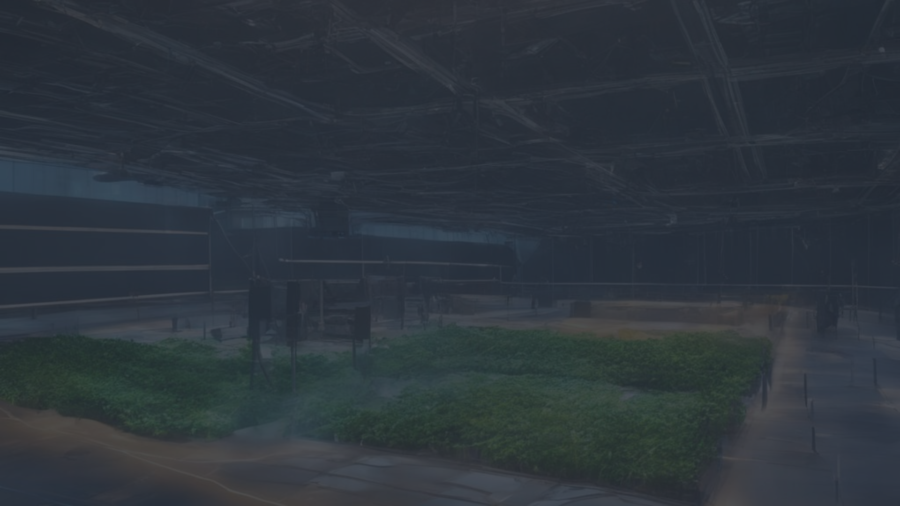
Future Scope
1
Integrate advanced wireless sensor networks for real-time data on crop conditions.
2
Explore image processing for precise wild animal detection.
3
Investigate sophisticated alert mechanisms beyond SMS.

Slide 8





Methodology
Identify the goals, limitations and conduct research related to technology that can be used.
The design that include the hardware components, such as microcontrollers, sensors as well as the software tools required.
Develop a prototype of the smart crop protection system which can be used for testing and refining the design.
Test the prototype under various conditions to ensure that it works as expected. Based on the testing results, refine the design to address any issues that were identified during testing.
Document the design, testing, process, including any modifications made to the design. Present the results of the project.

Slide 9
COMPONENTS
Hardware components
Software Tools
Microcontroller ESP32
Arduino IDE
GSM module
Tinkercad
PIR sensor
MAX232 Sensor
LCD Panel
Buzzer
Power Supply

Slide 10

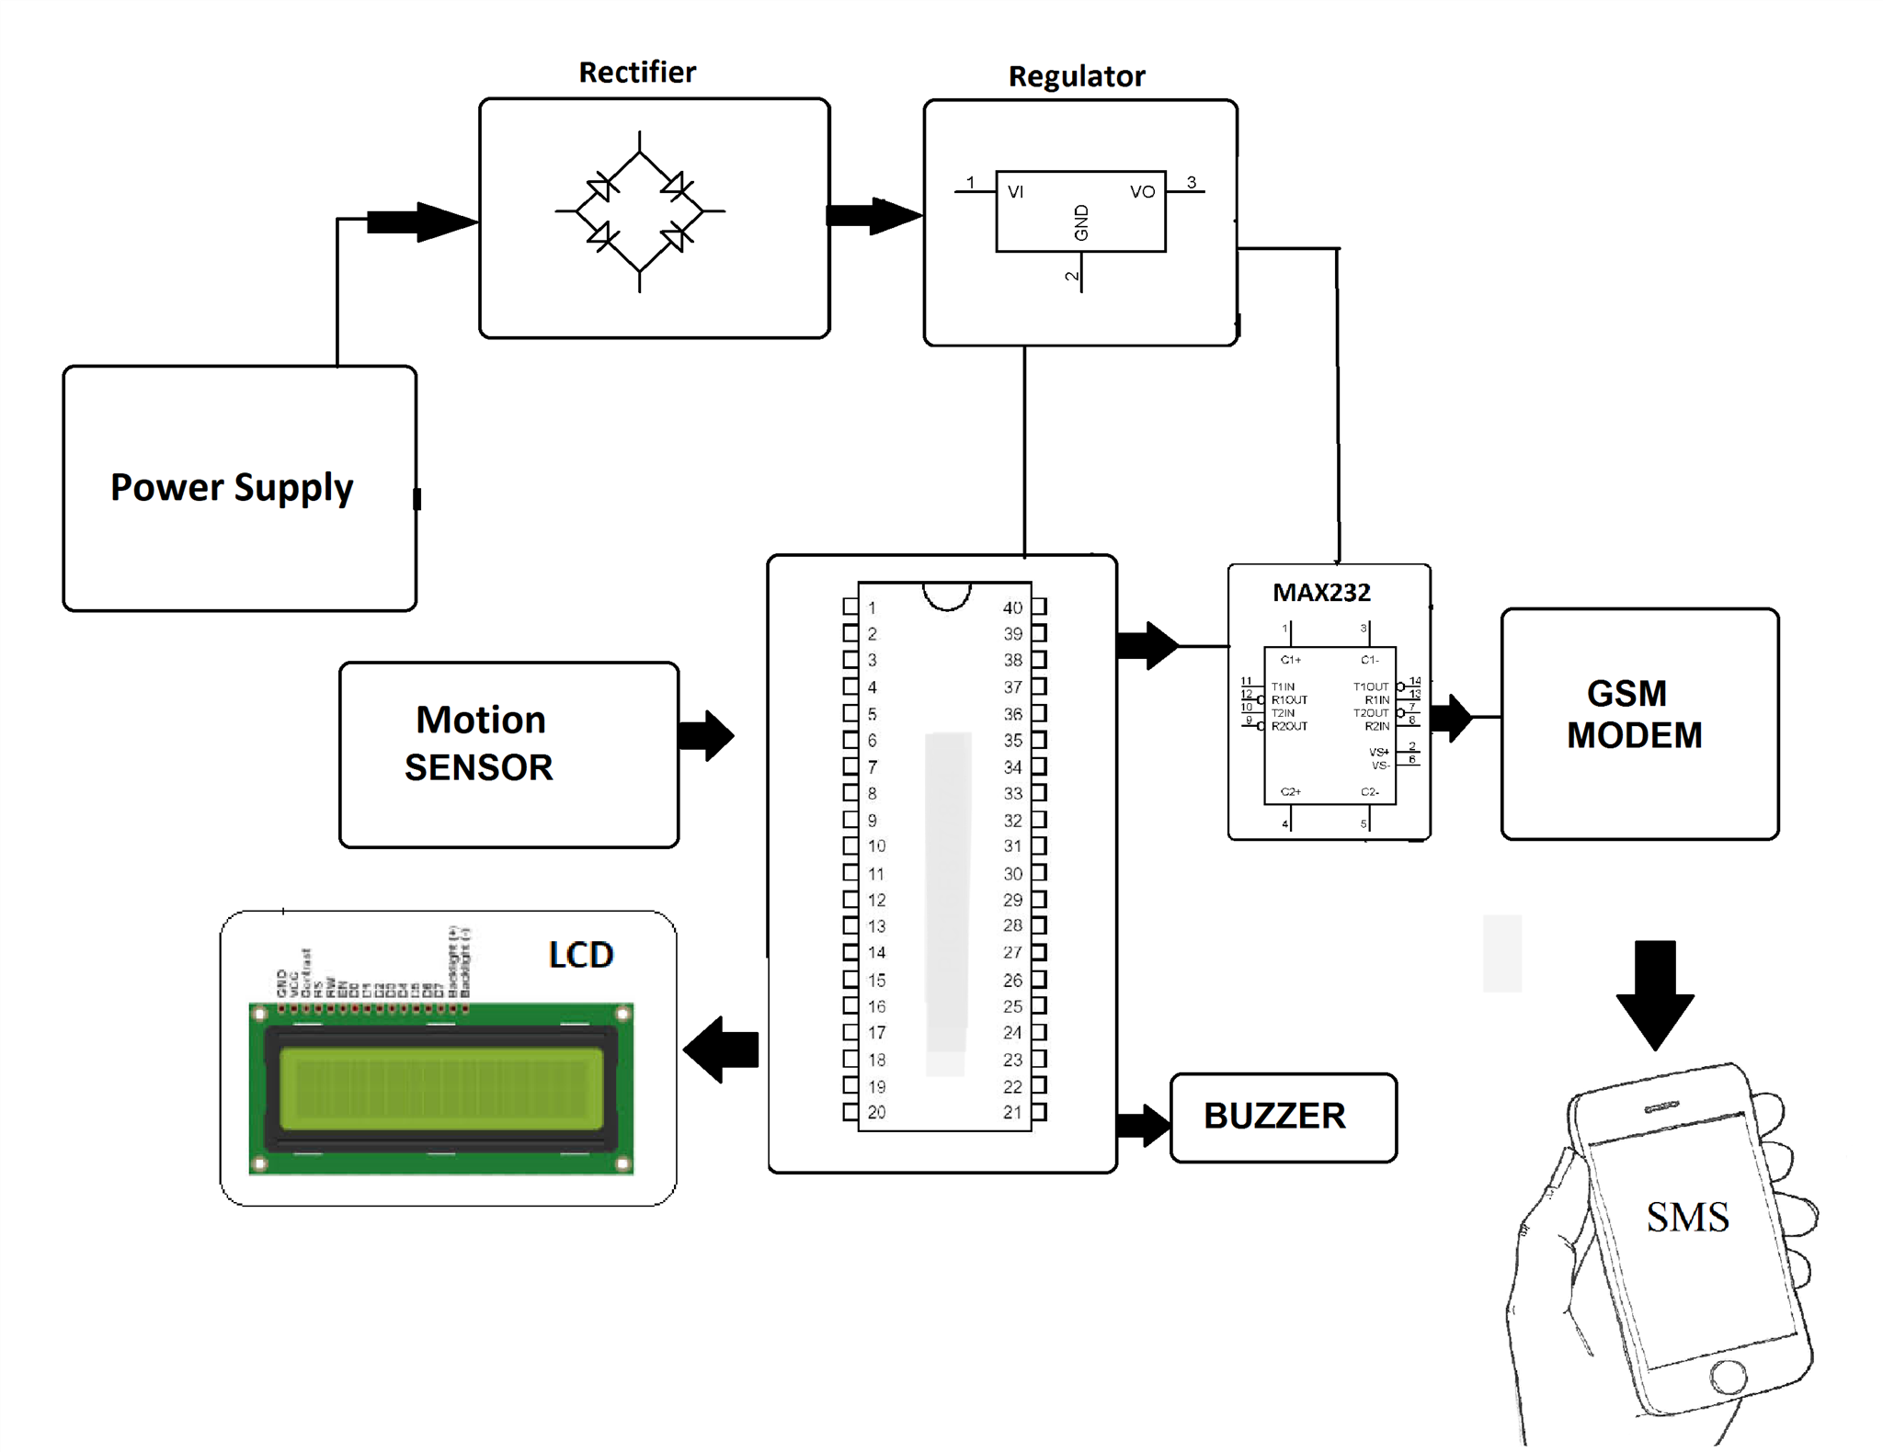
Block Diagram
Visualize key components: sensors, ESP32 Microcontroller, communication module, and protective measures.
ESP32
Fig. Block Diagram

Slide 11

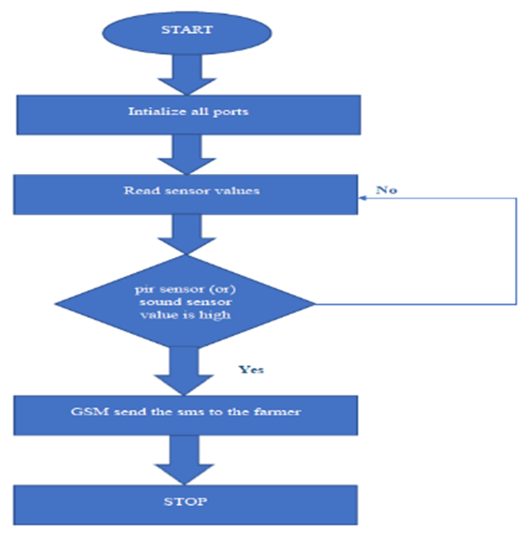
Flowchart
Fig. Flowchart

Slide 12





Action Plan
Topic Approval
Components Selection
Hardware Implementation-1
Hardware Implementation-2
Final Submission & Report

Slide 13
References:
No. | Reference Links for Research Papers
1. | https://iarjset.com/papers/smart-crop-protection-using-arduino/
2. | https://www.jetir.org/view?paper=JETIR2203572
3. | https://ijcrt.org/papers/IJCRTO020033.pdf
​

Slide 14
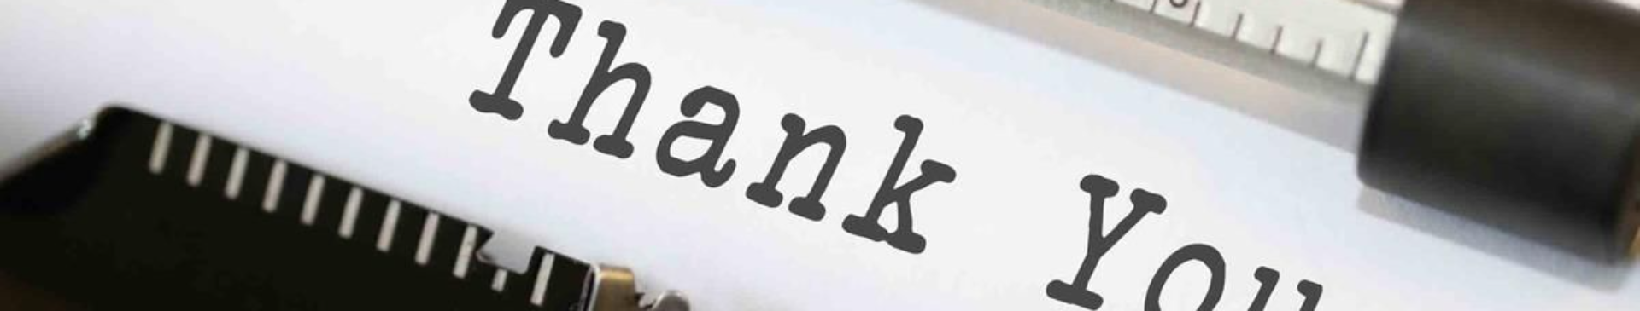
Thank You !!!

